Slide 1
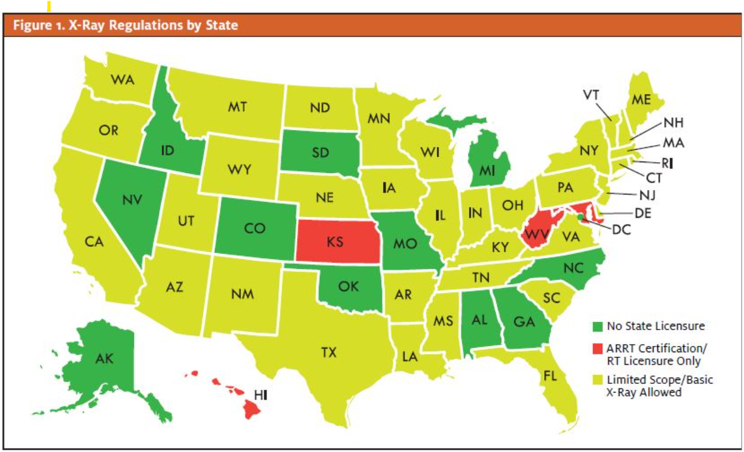

Slide 2
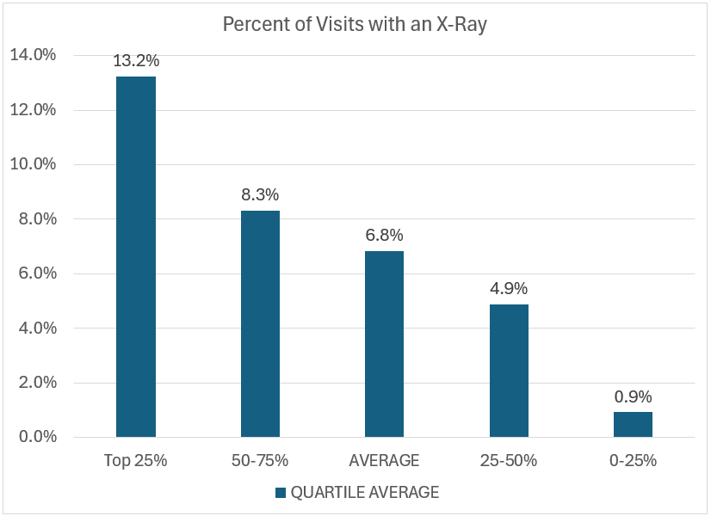
Percent of Urgent Care Visits w/X-ray

Slide 3
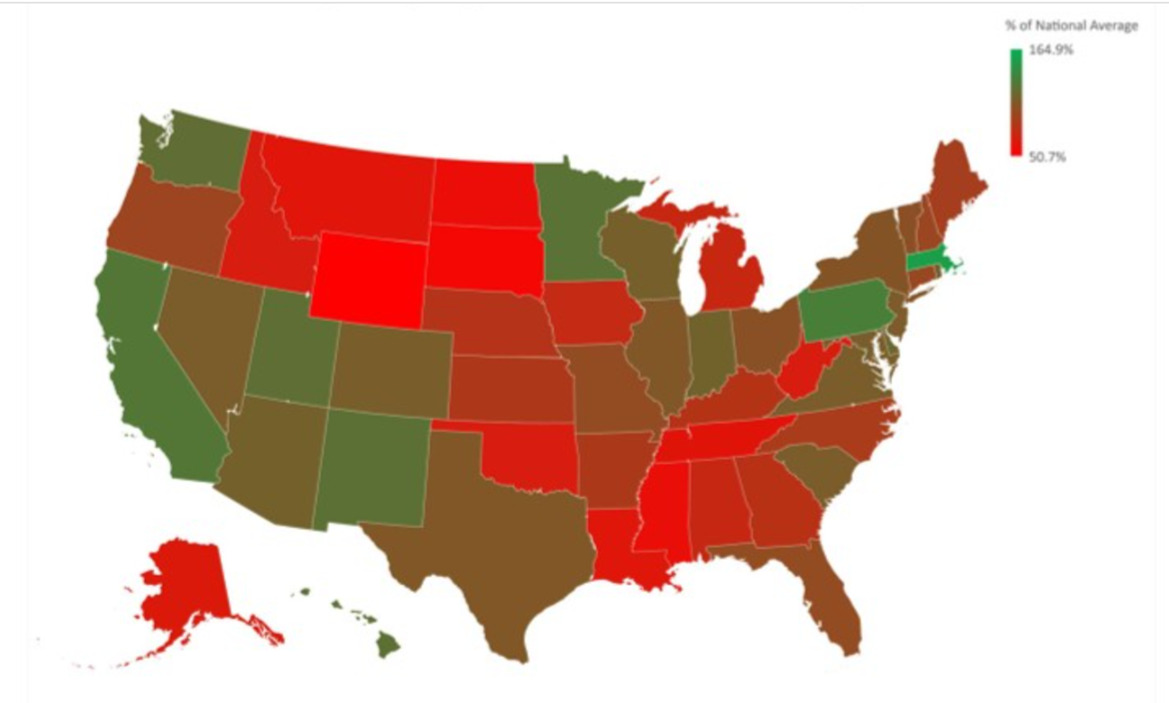
Population per Urgent Care Center (as a Percent of National Average)
Green=Less Access Red=Greater Access

Slide 4
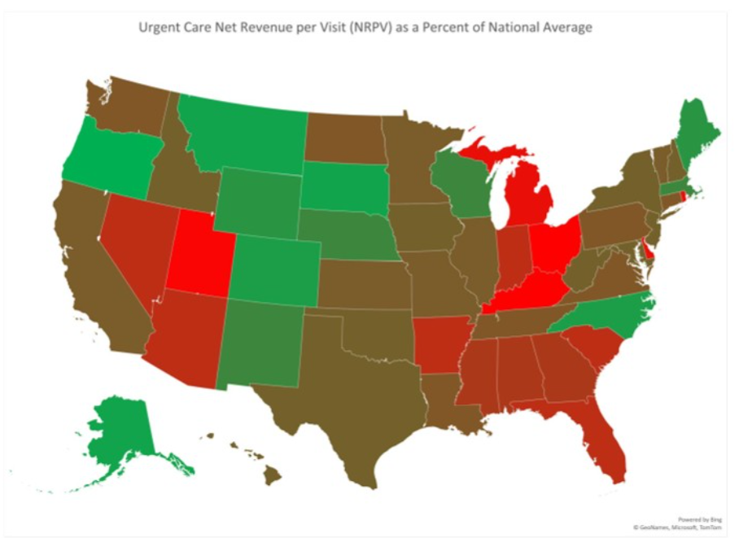
Net Revenue per Visit (as a Percent of National Average)
Green=Greater Payment Red=Lesser Payment

Slide 5
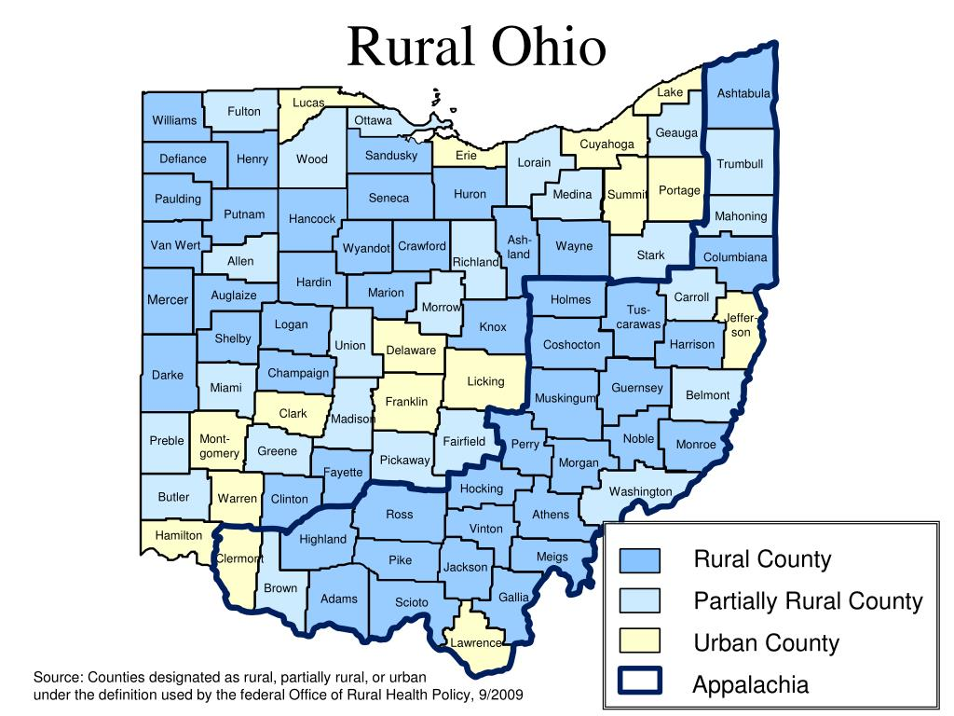
Ohio is the 7th most populous state in the nation but 18% or 1.8M people live in rural, non-metro areas.
1/3 of those (28% of whom are on Medicaid) have no after-hours access to x-ray.
Of 54 Ohio Rural Counties:
2 w/NO NIGHT OR WEEKEND ACCESS (no hospital facility, no clinics open after 5:00pm): 26,915 people
15 w/REGISTERED HOSPITAL FACILITY BUT NO AFTER-HOURS CLINIC ACCESS: 602,208 people

Slide 6
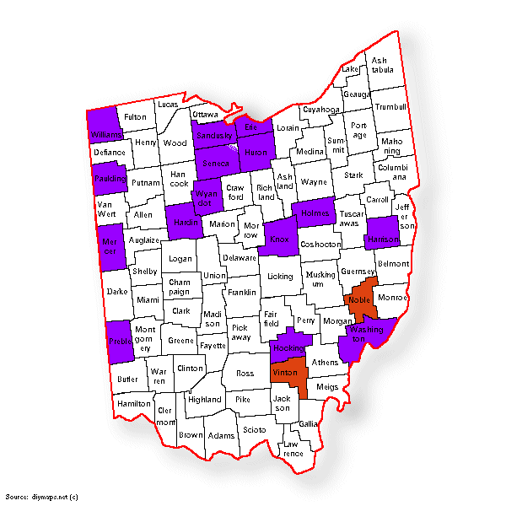
In just 17 rural counties lacking evening and weekend x-ray access…
12,000 to 20,000 visits by Medicaid patients to hospital facilities could have been served by urgent care.
Resulting in extra costs of $16,000,000 to $26,000,000 to Ohio taxpayers.

